Slide 2
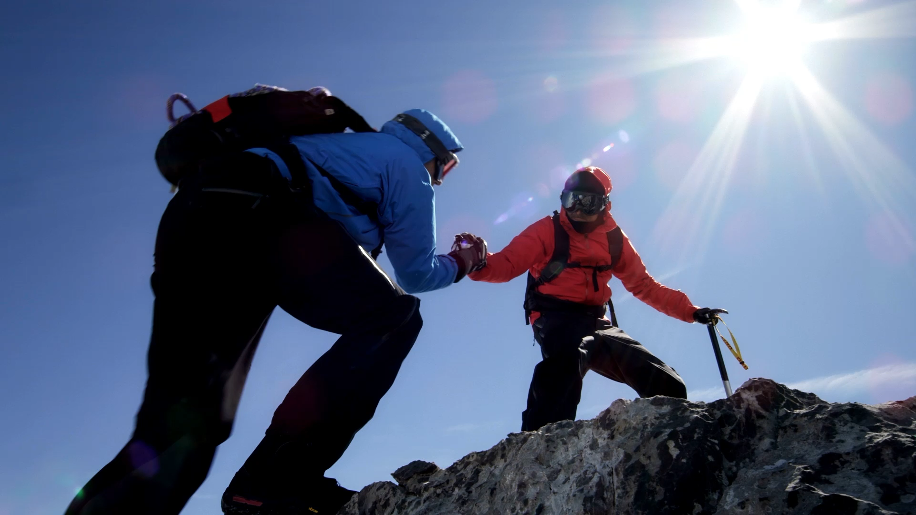
District Deputy
Midyear Meeting

Slide 3
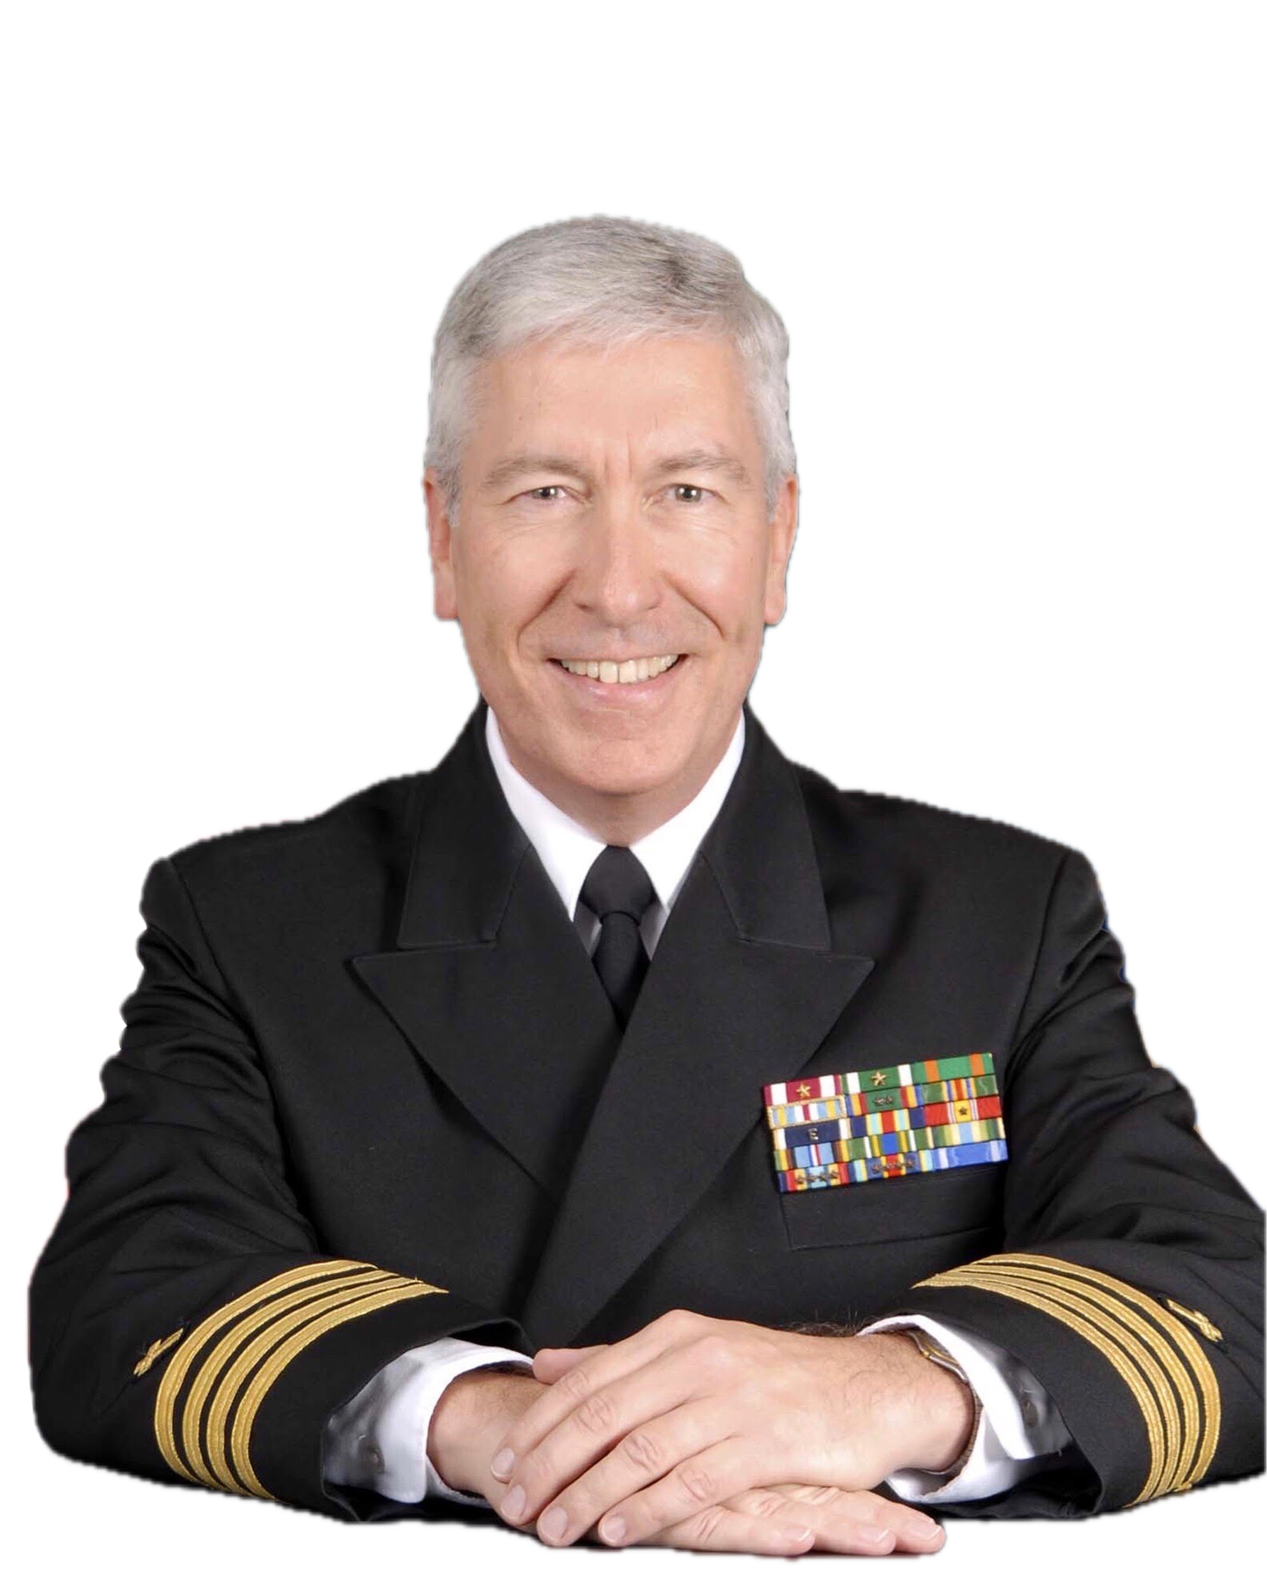
Opening Prayer

Slide 4
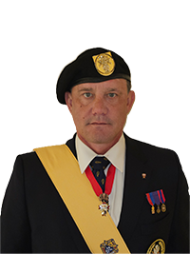
Pledge of Allegiance

Slide 5
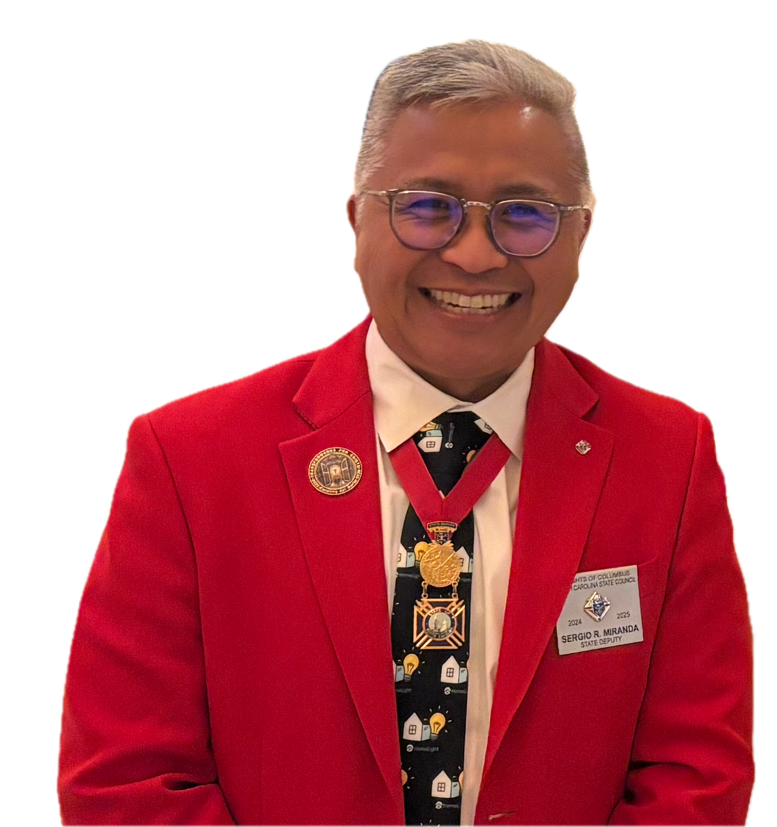
Introductions
Welcome Address

Slide 6
State Chaplain’s
Report

Slide 7
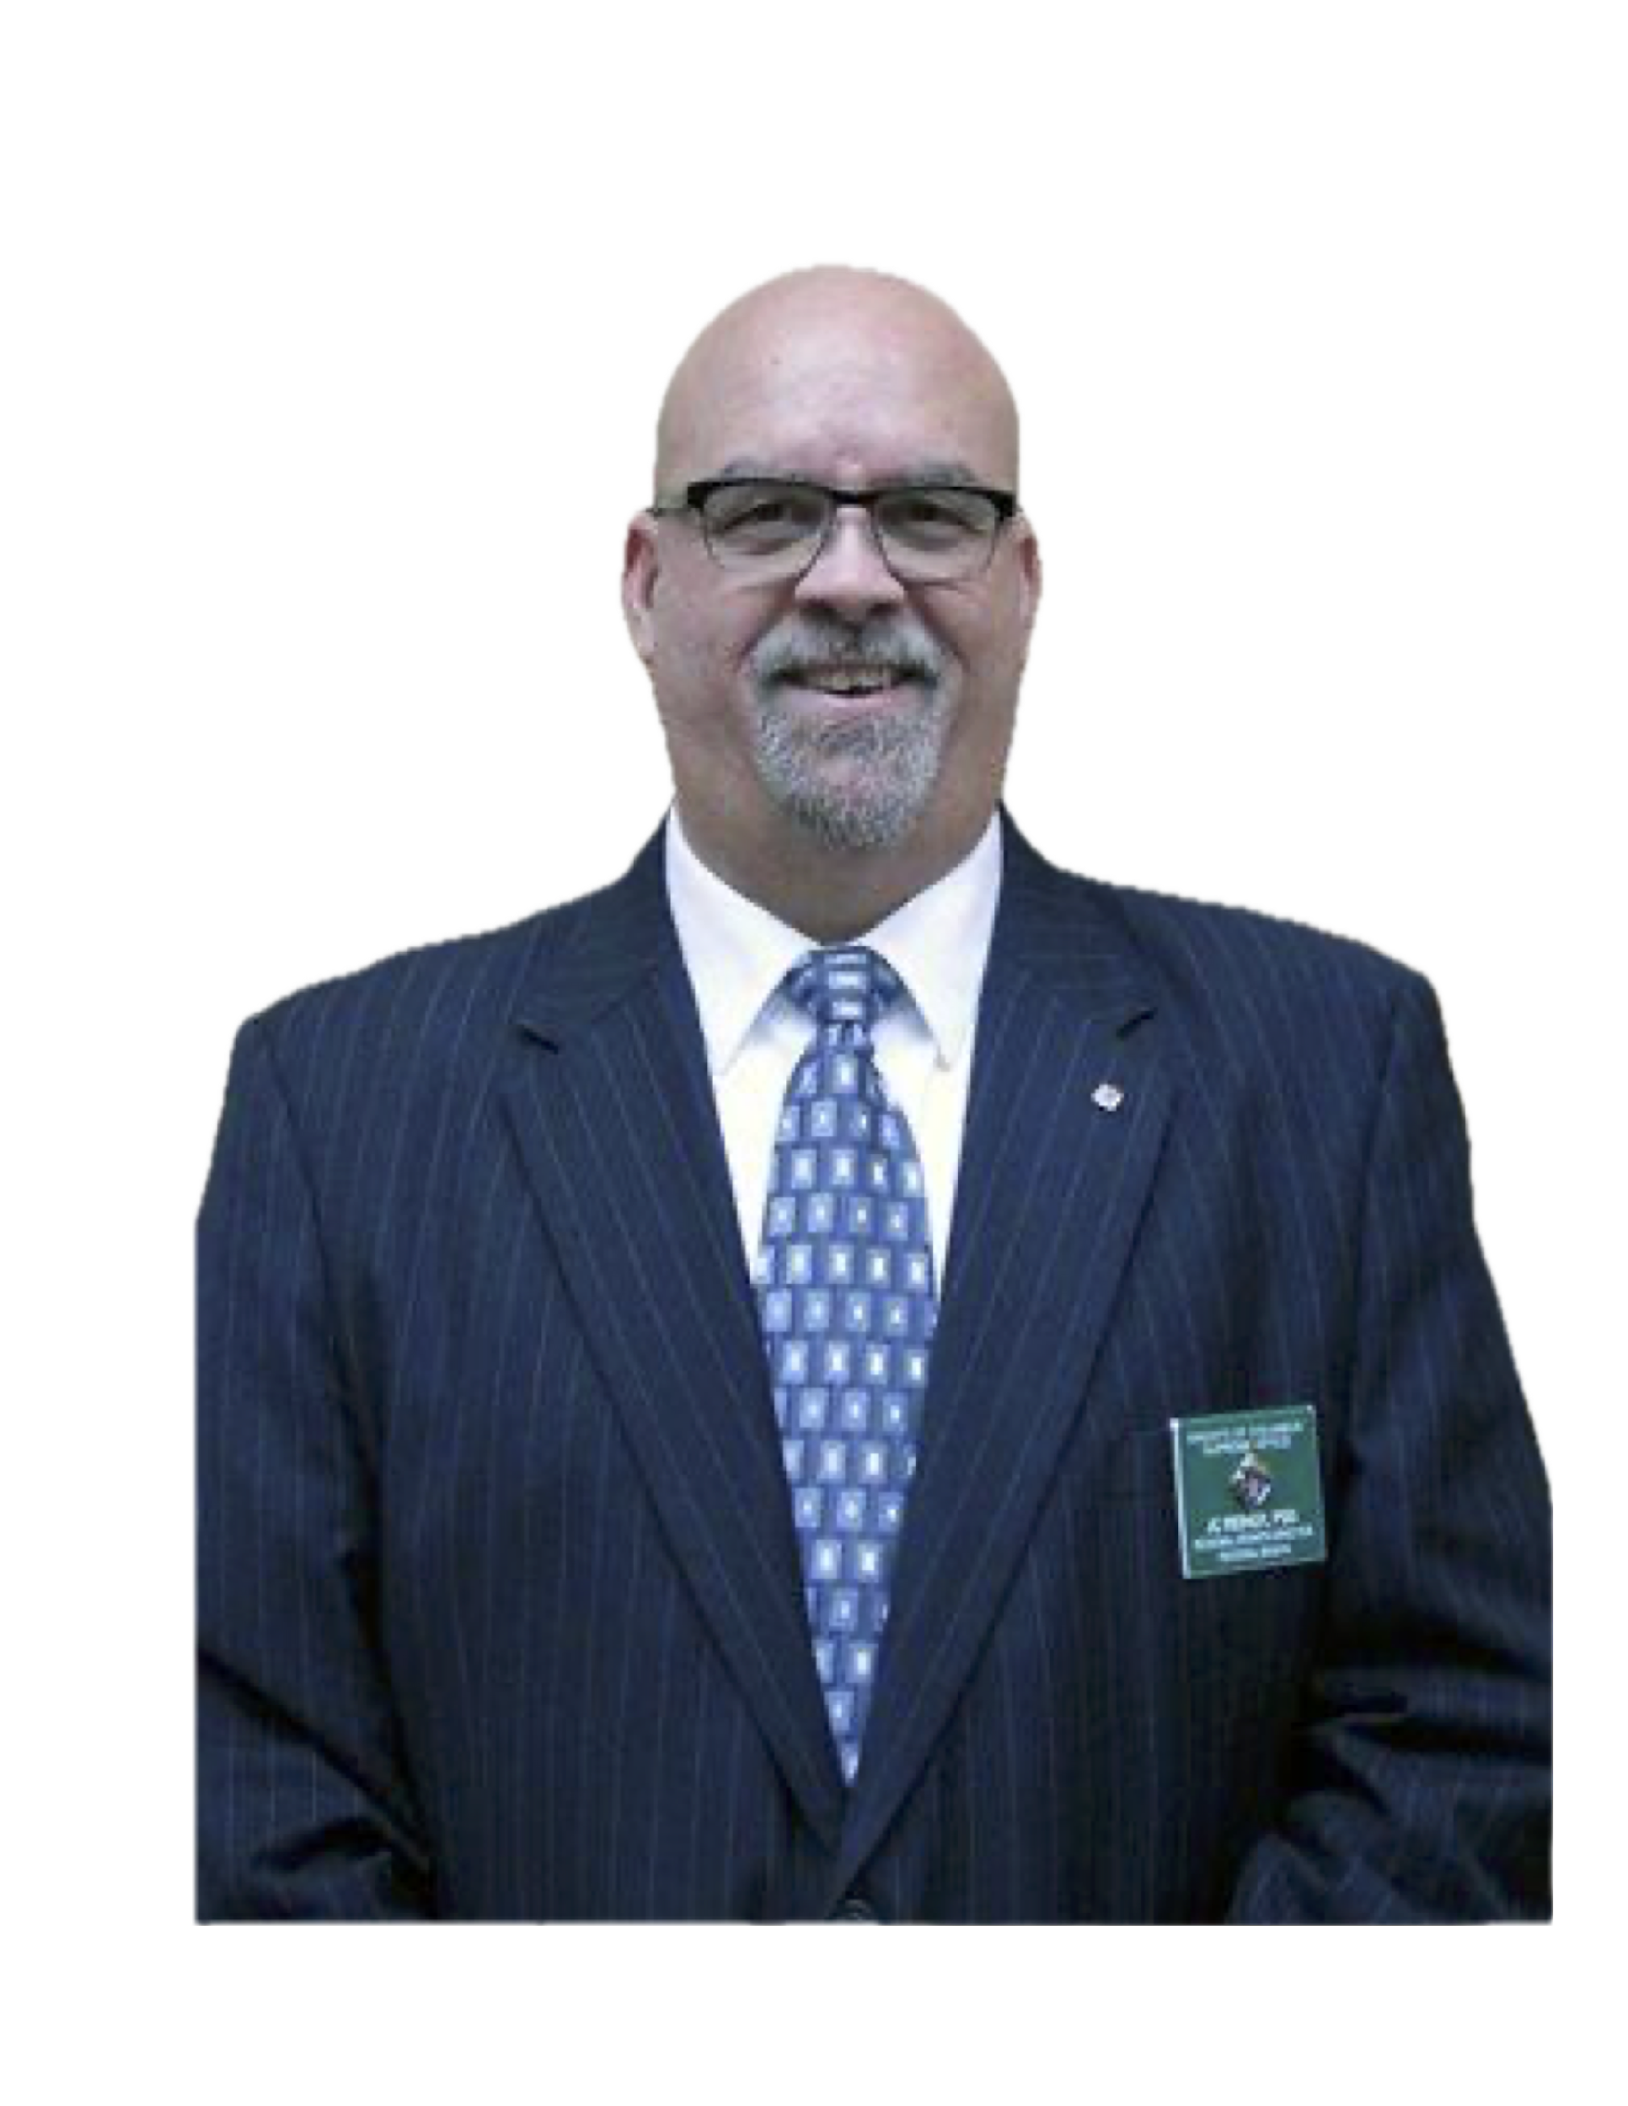
Supreme
Representative’s
Report

Slide 8
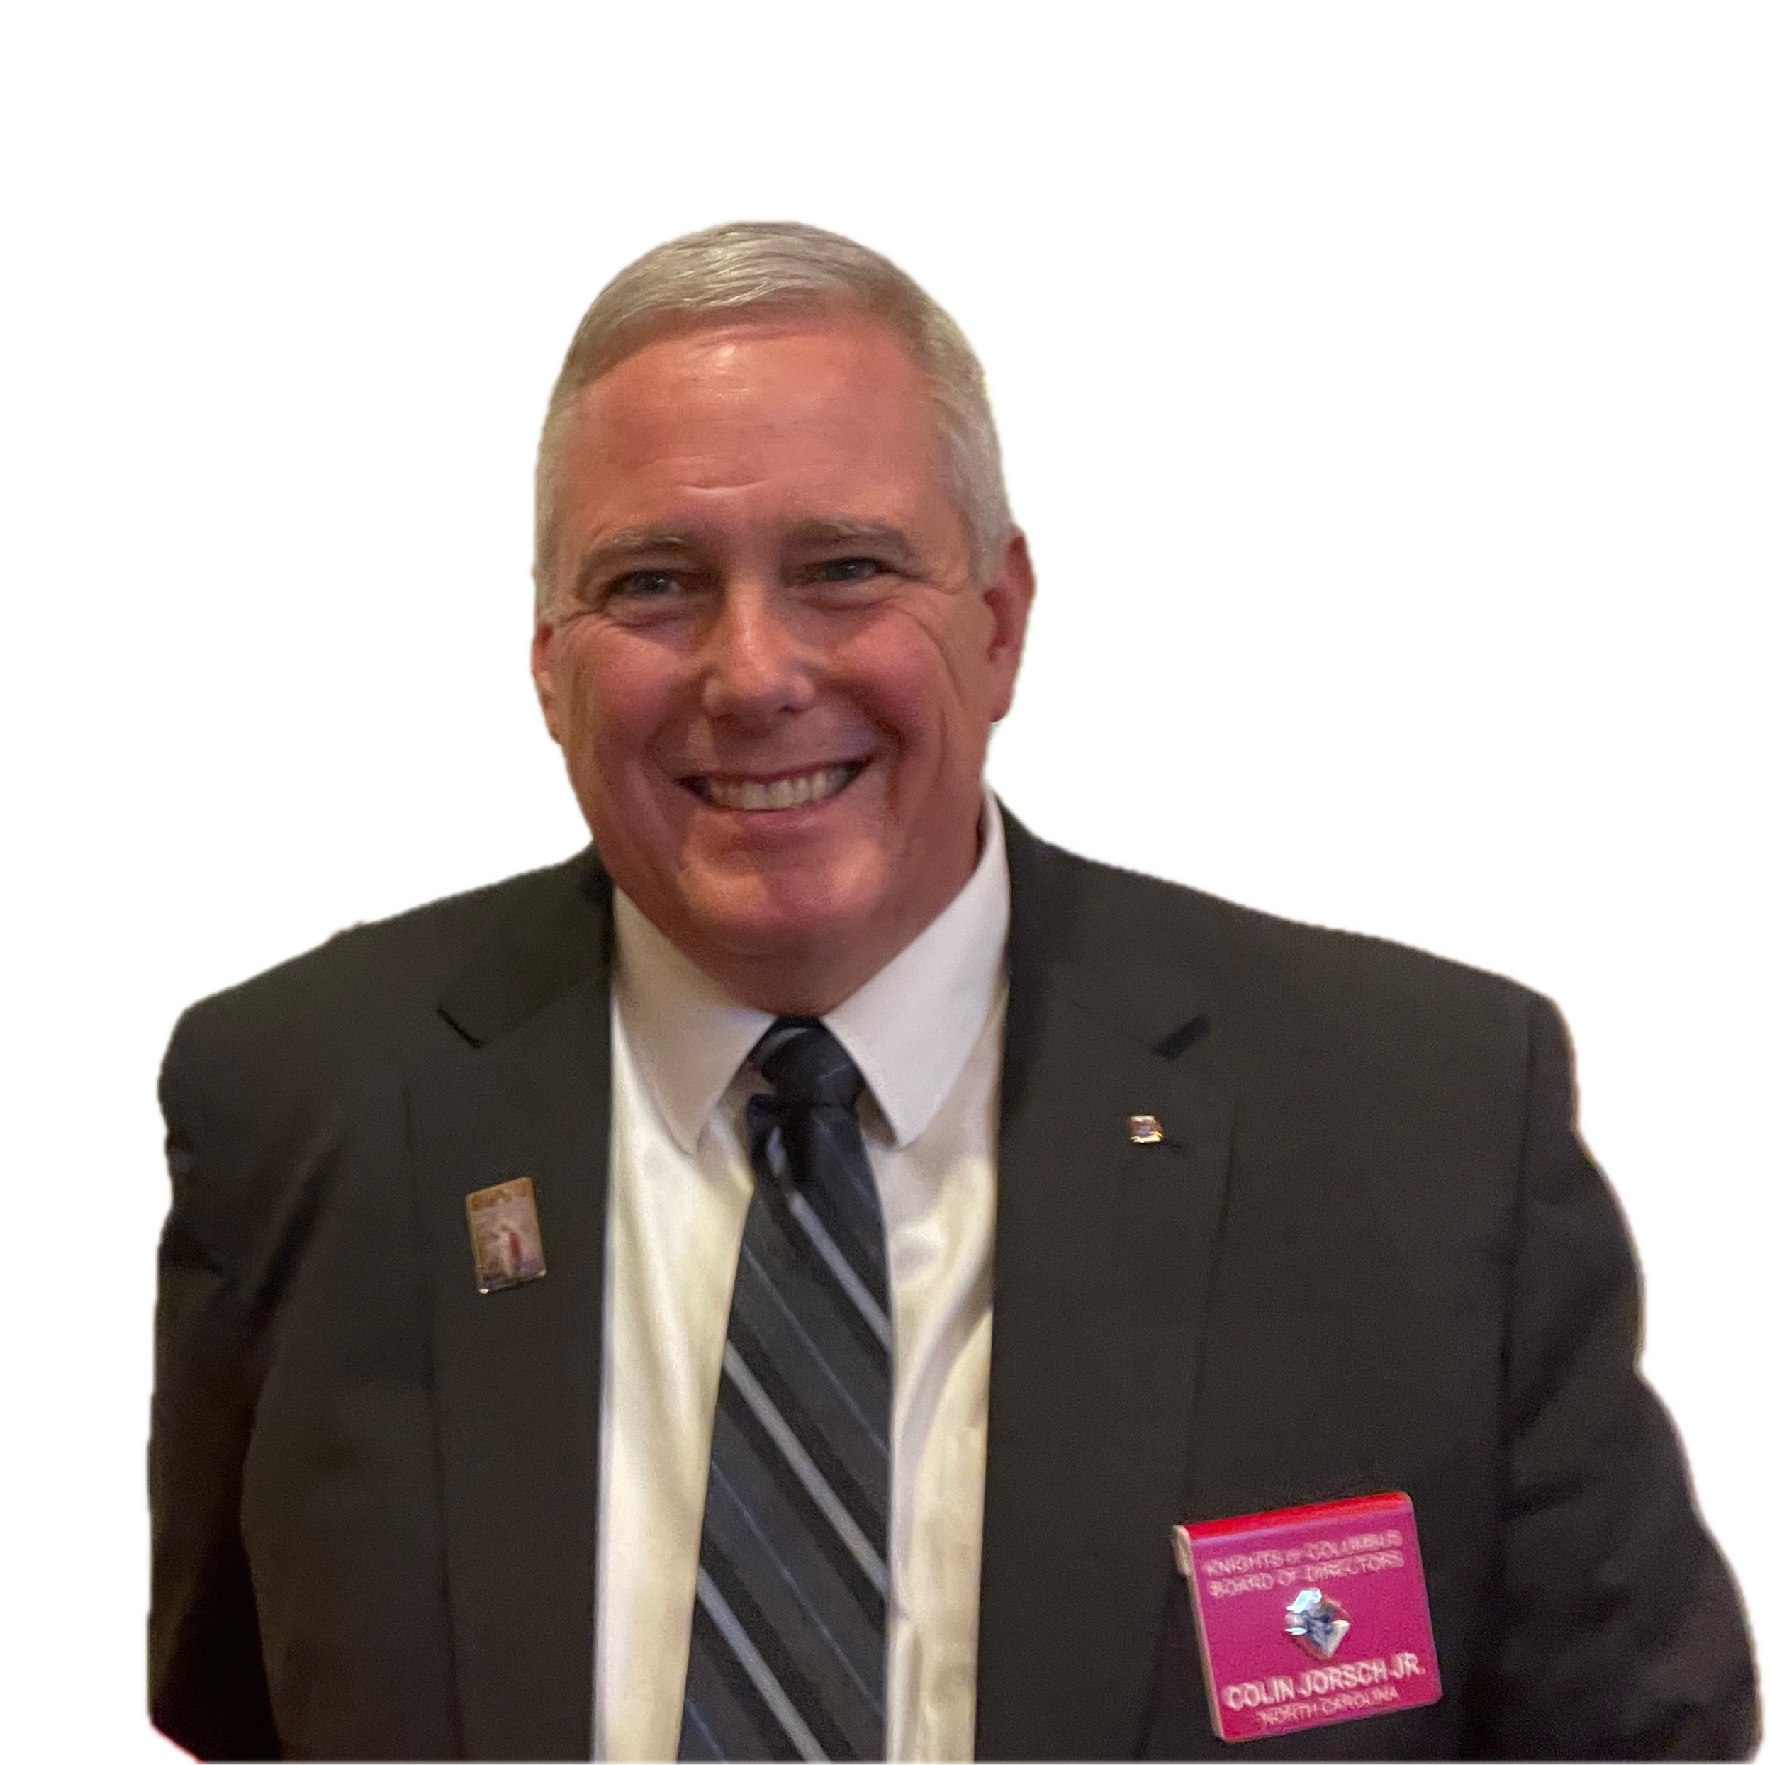
Supreme
Director’s
Report

Slide 9
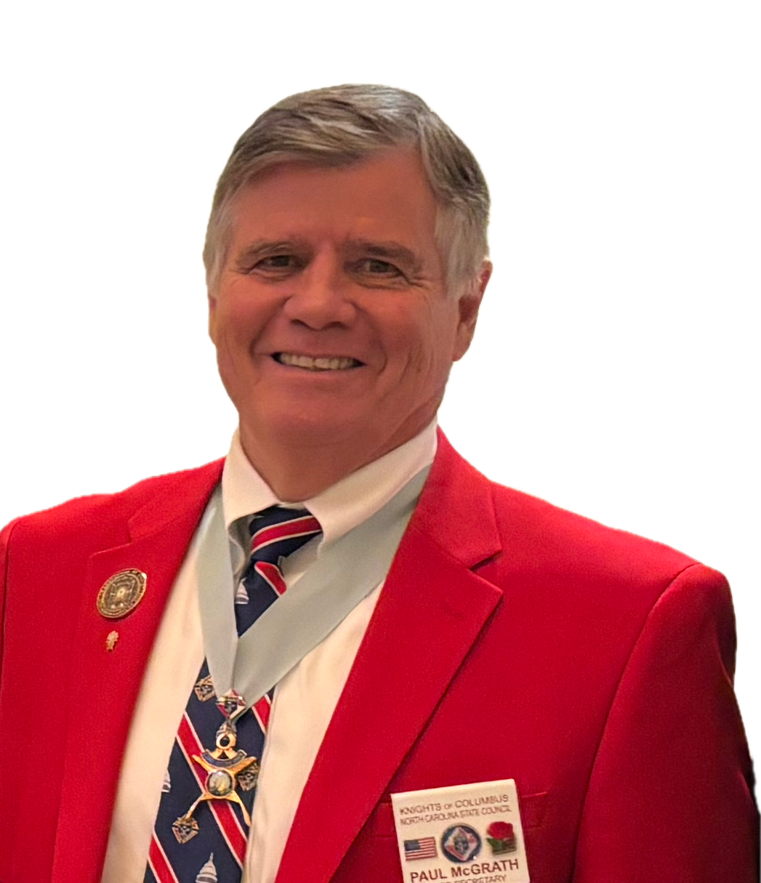
Membership

Slide 10
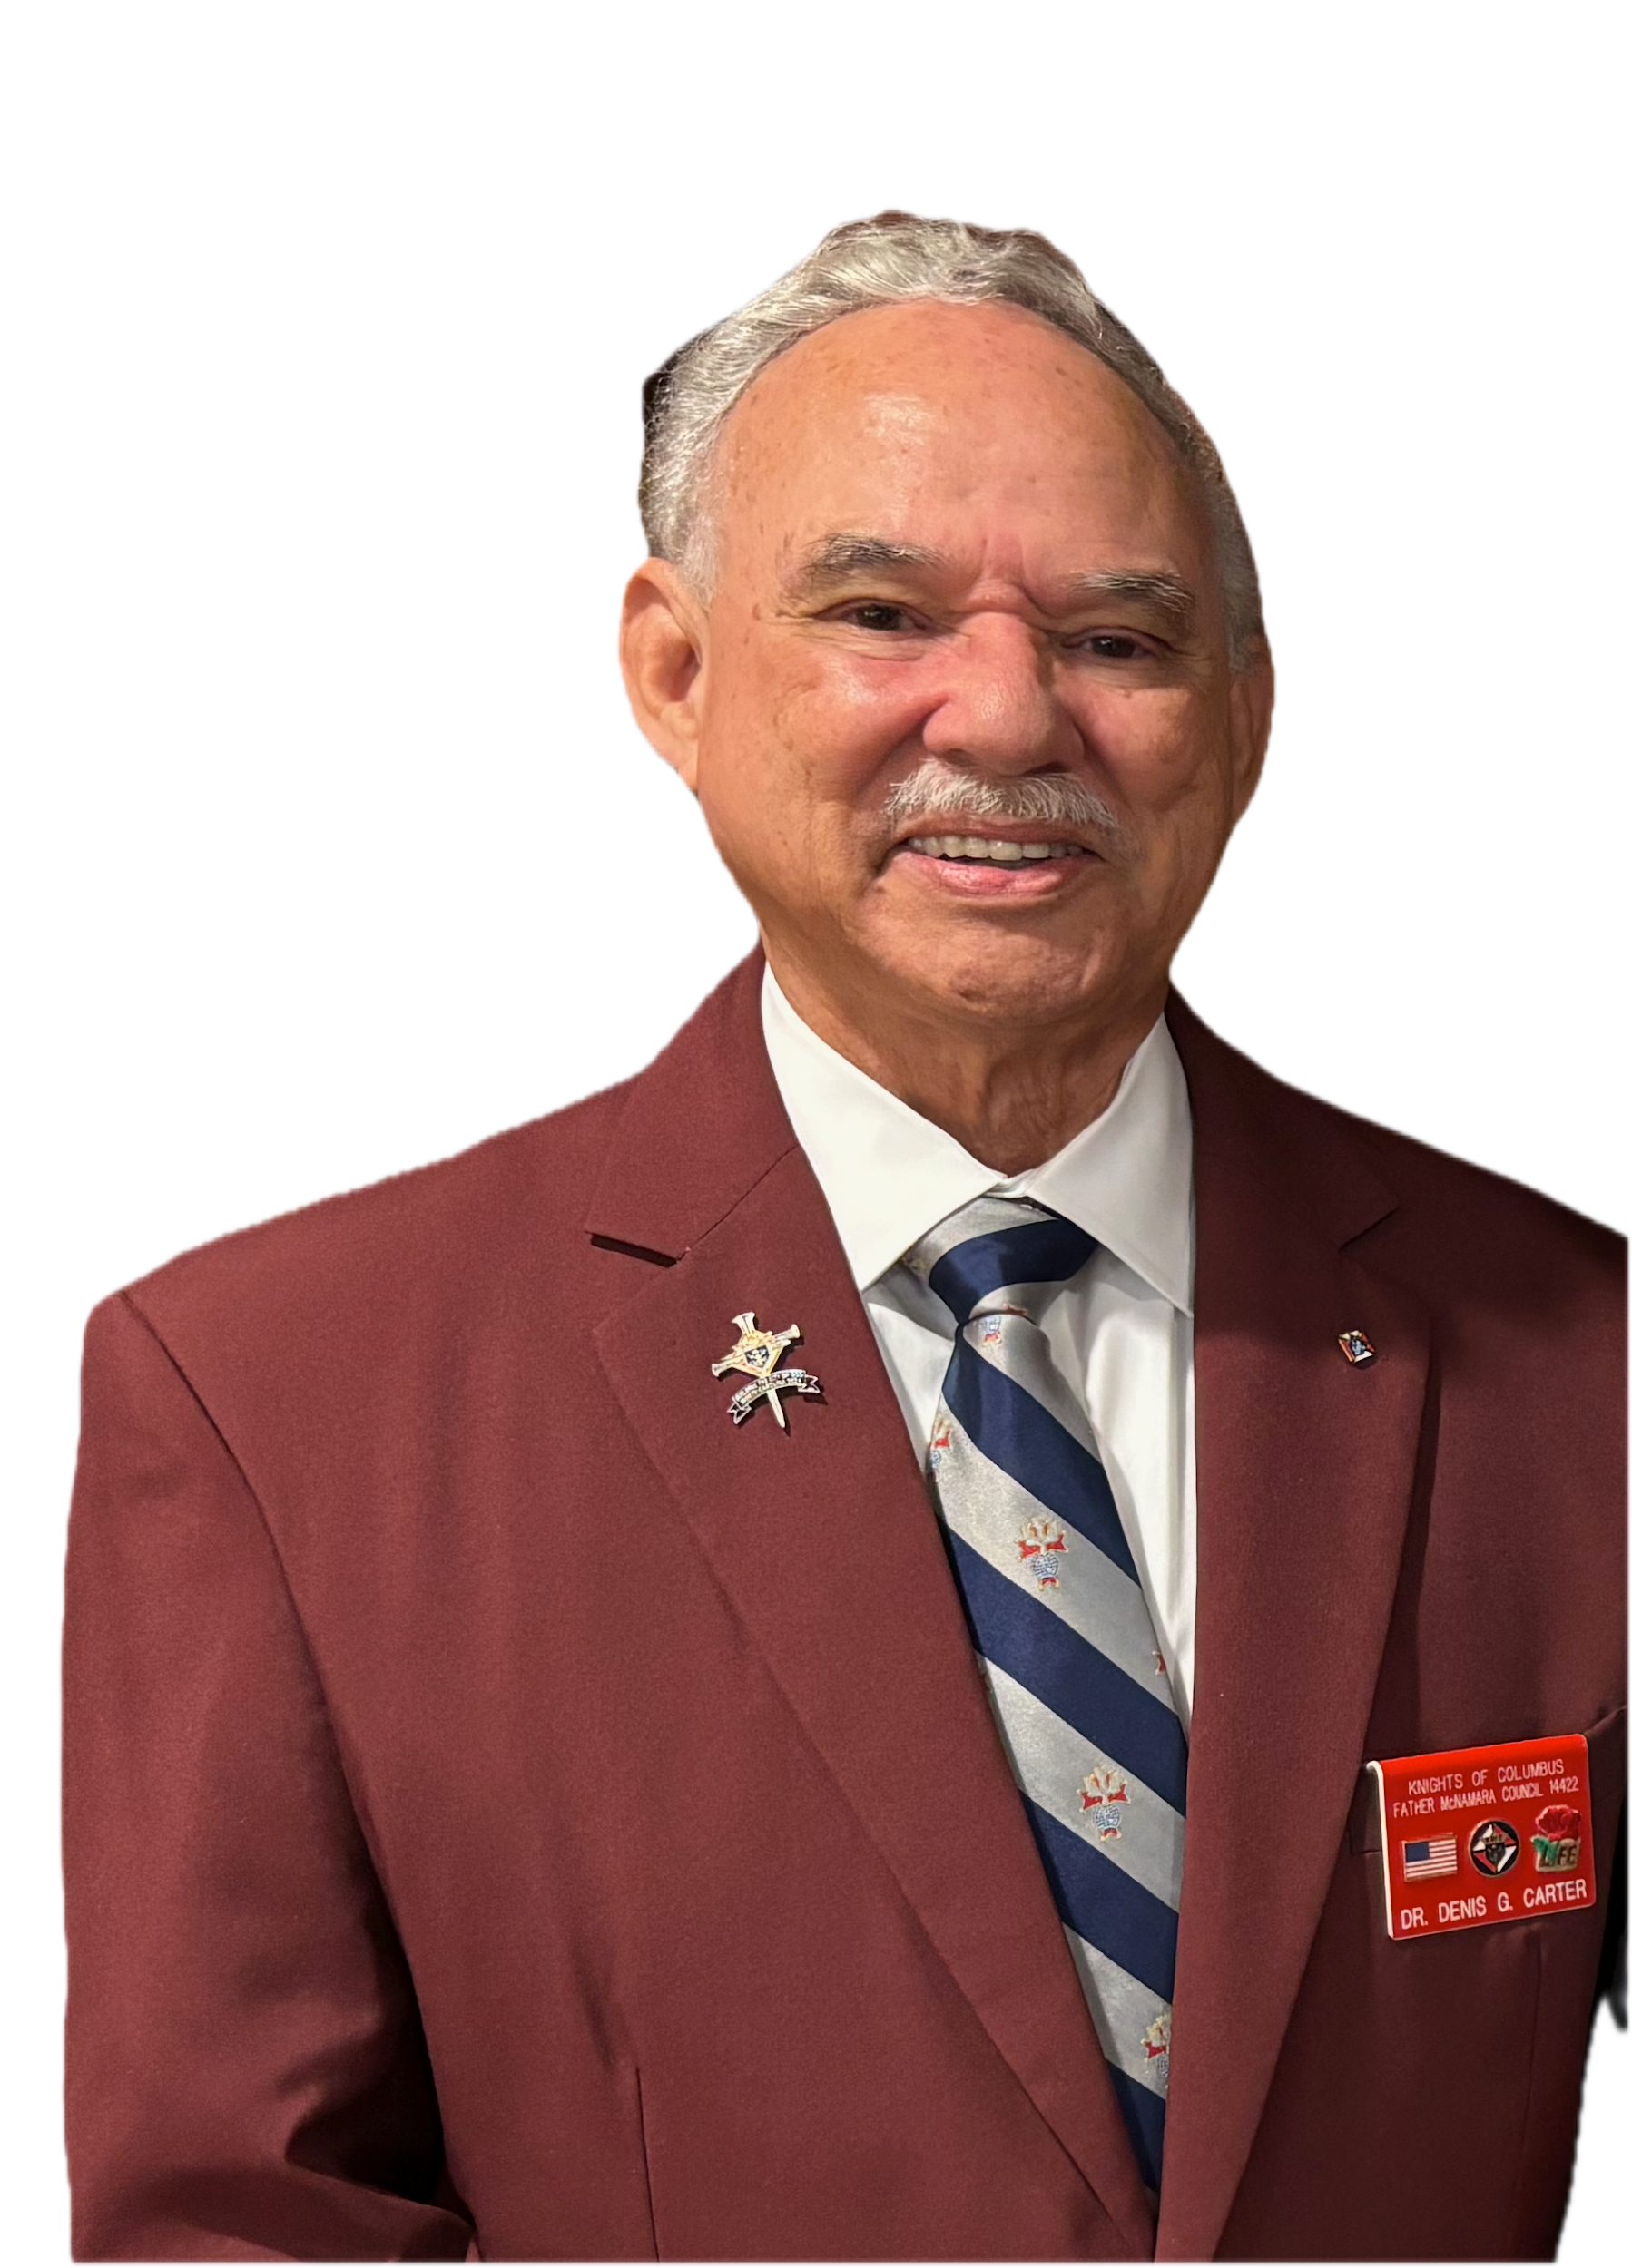
Cor

Slide 11
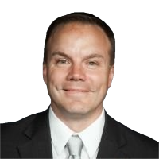
Insurance

Slide 12
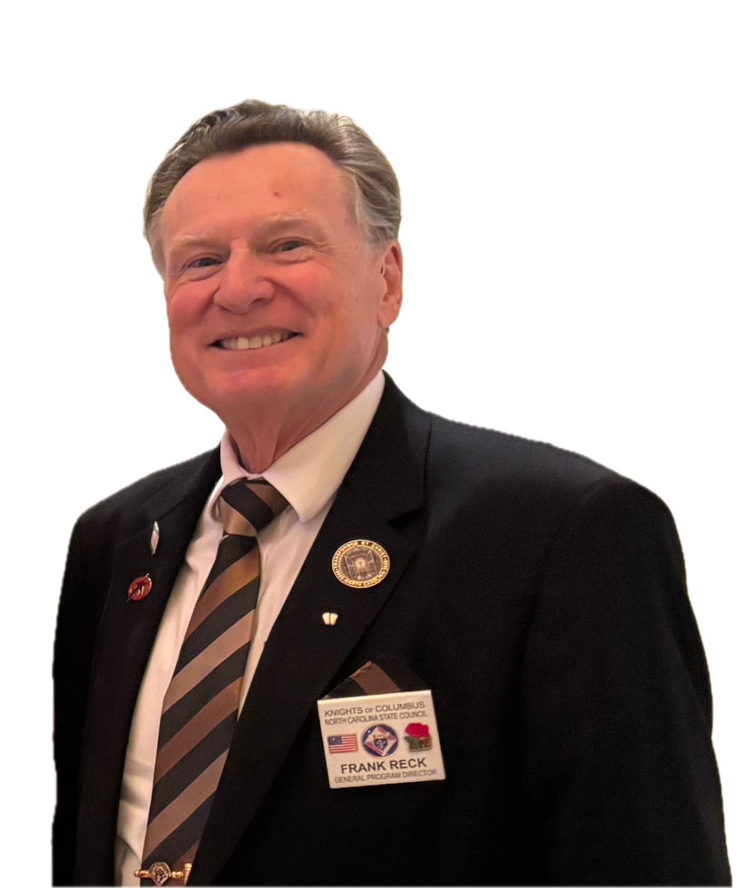
Programs

Slide 13
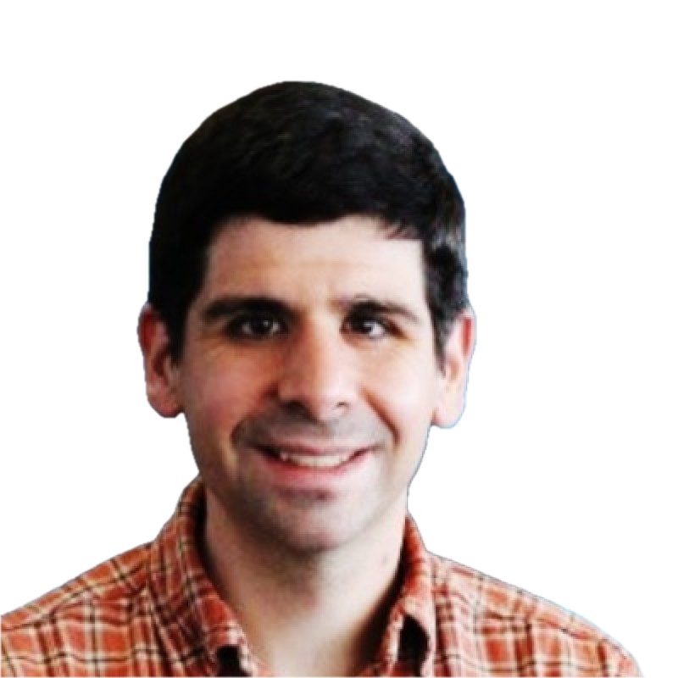
Convention 2026

Slide 14
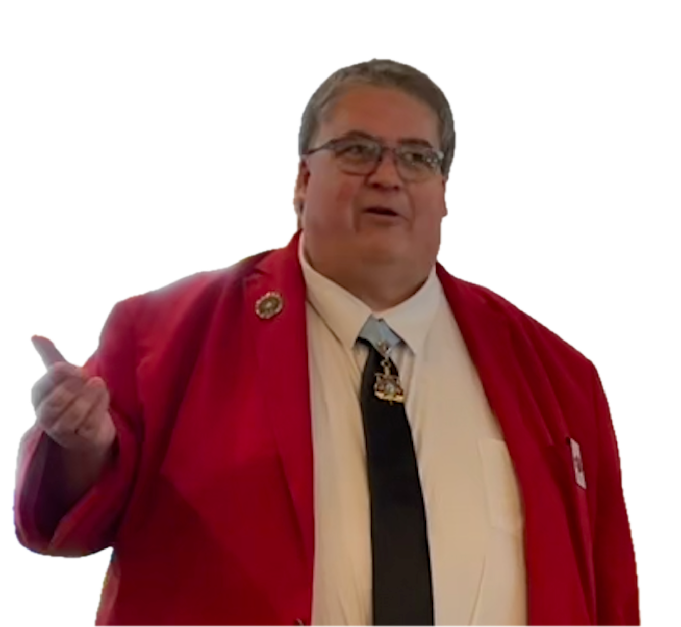
Electronic Voting

Slide 15
Vote – Patron Saint of the MYM
Favorite Gospel
St. Christopher
St. Francis of Assisi
St. Joseph
St. Michael the Archangel

Slide 16
Vote – Month of the Year (pick 4)
January
February
March
April
May
June
July
August
September
October
November
December

Slide 17
Winners!
Patron Saint for MYM
Favorite 4 Months of the Year

Slide 18
This Evening
5:30pm – Mass – Salon AB
7:00pm – Dinner and Awards – Timberlake
Hospitality – after dinner – Room 730
Tomorrow
Meeting restarts at 8:30am

Slide 20
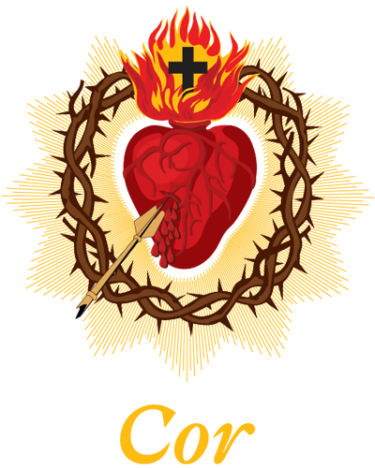

Slide 21
This Morning
9:30am - Round Robin
11:00am – Regional Breakouts
11:30am – Closing

Slide 22
Round Robin
Session 1: 9:30am (30 minutes)
Break (15 minutes)
Session 2: 10:15am (30 minutes)
Sessions:
1-on-1 by Region (Salon C)
Programs/Membership (Salon D)
Groups:
Group A: Regions 1, 2, 3
Group B: Regions 4, 5, 6 & 7
Return by 11:00am for Regional Breakouts

Slide 23
Regional Breakouts
Return by 11:30am for Closing

Slide 24
Closing Comments

Slide 25
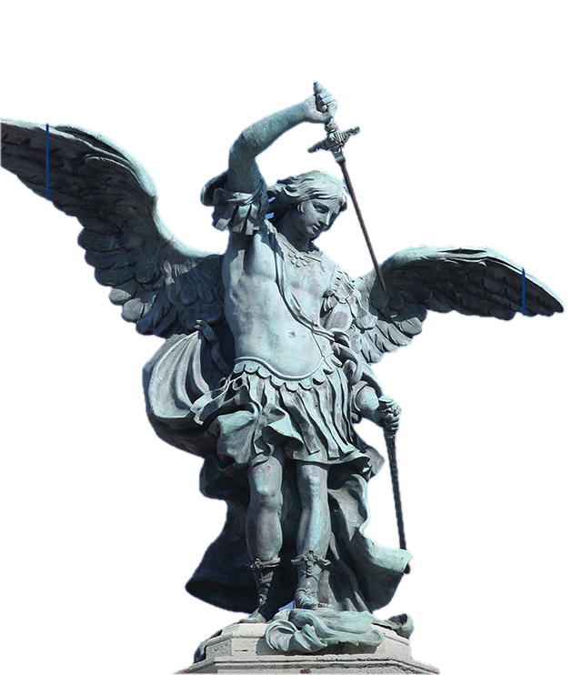
Closing Prayer
Saint Michael the Archangel, defend us in battle; be our protection against the wickedness and snares of the devil. May God rebuke him, we humbly pray, and do thou, O Prince of the heavenly host, by the power of God, cast into hell Satan and all the evil spirits who prowl about the world seeking the ruin of souls. Amen

Slide 26
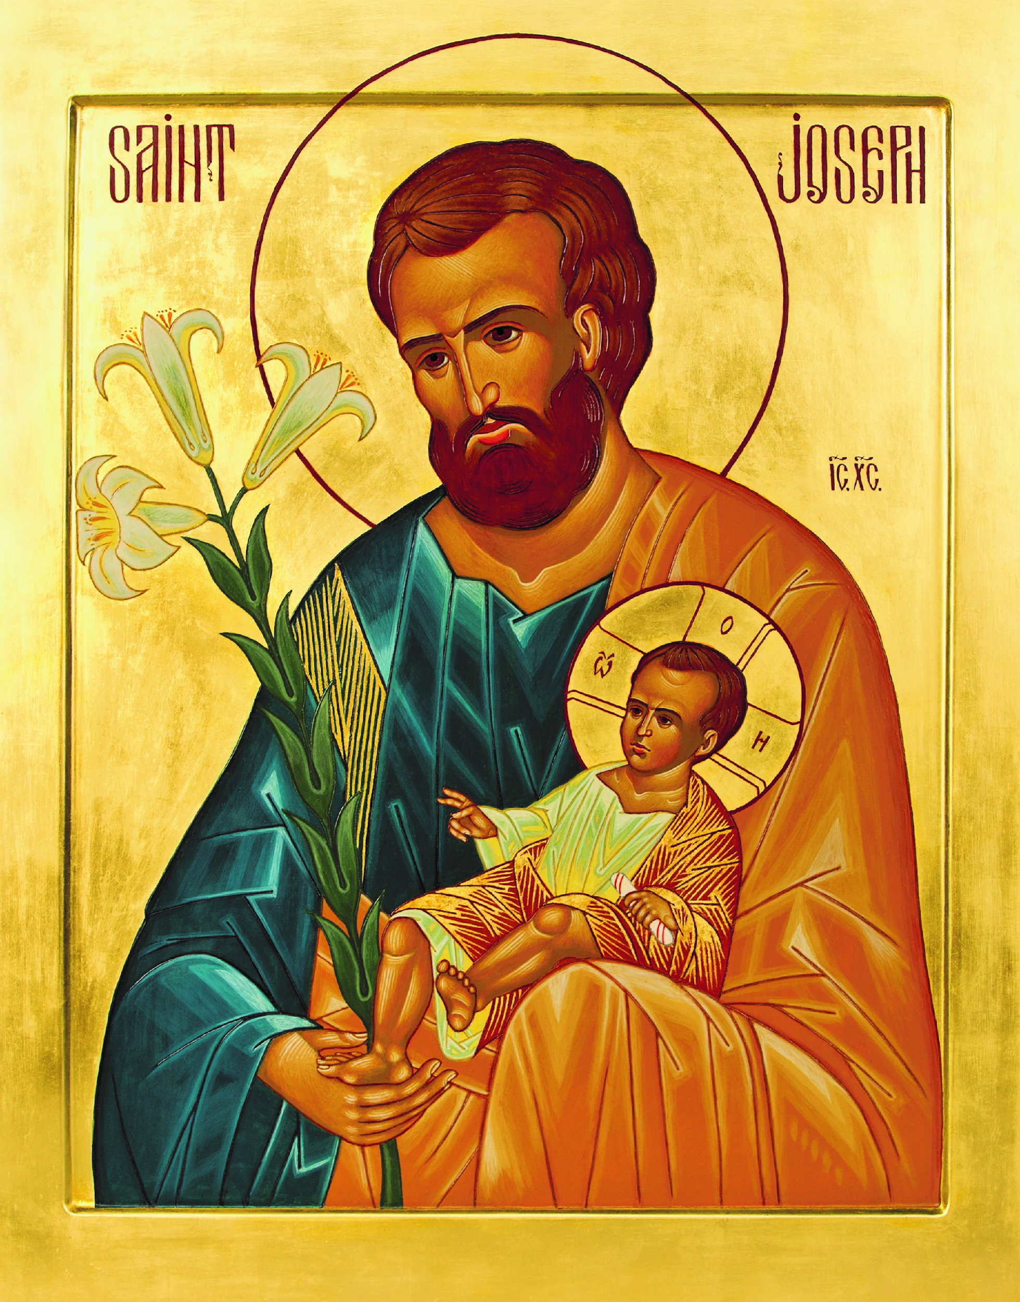
Closing Prayer - Act of Consecration to St. Joseph
O dearest St. Joseph, I consecrate myself to your honor and give myself to you, that you may always be my father,
my protector and my guide in the way of salvation.
Obtain for me a greater purity of heart and fervent
love of the interior life.
After your example may I do all my actions for the greater glory of God, in union with the Divine Heart of Jesus and the Immaculate Heart of Mary.
O Blessed St. Joseph, pray for me, that I may share in the peace and joy of your holy death. Amen.

