Slide 2
District Deputy Deep Dive

Slide 3
DD as Coach Mentor
Primary Function:
Leadership development
Tools:
Fraternal Excellence Guide

Slide 4

DD as Advocate
Primary Function:
Governance and legal alignment
Tools:
Bylaws
Officer Desk Reference
Robert’s Rules

Slide 5
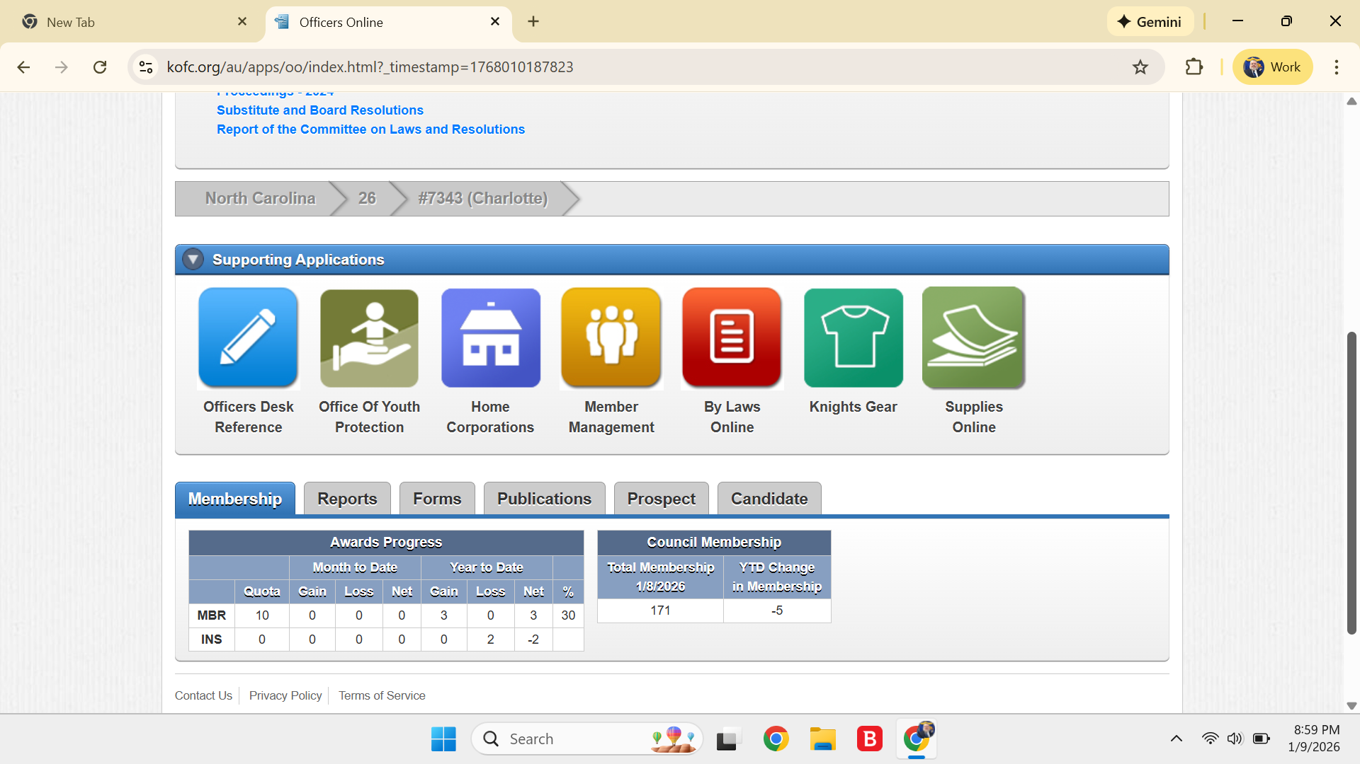
DD as Advocate

Slide 6
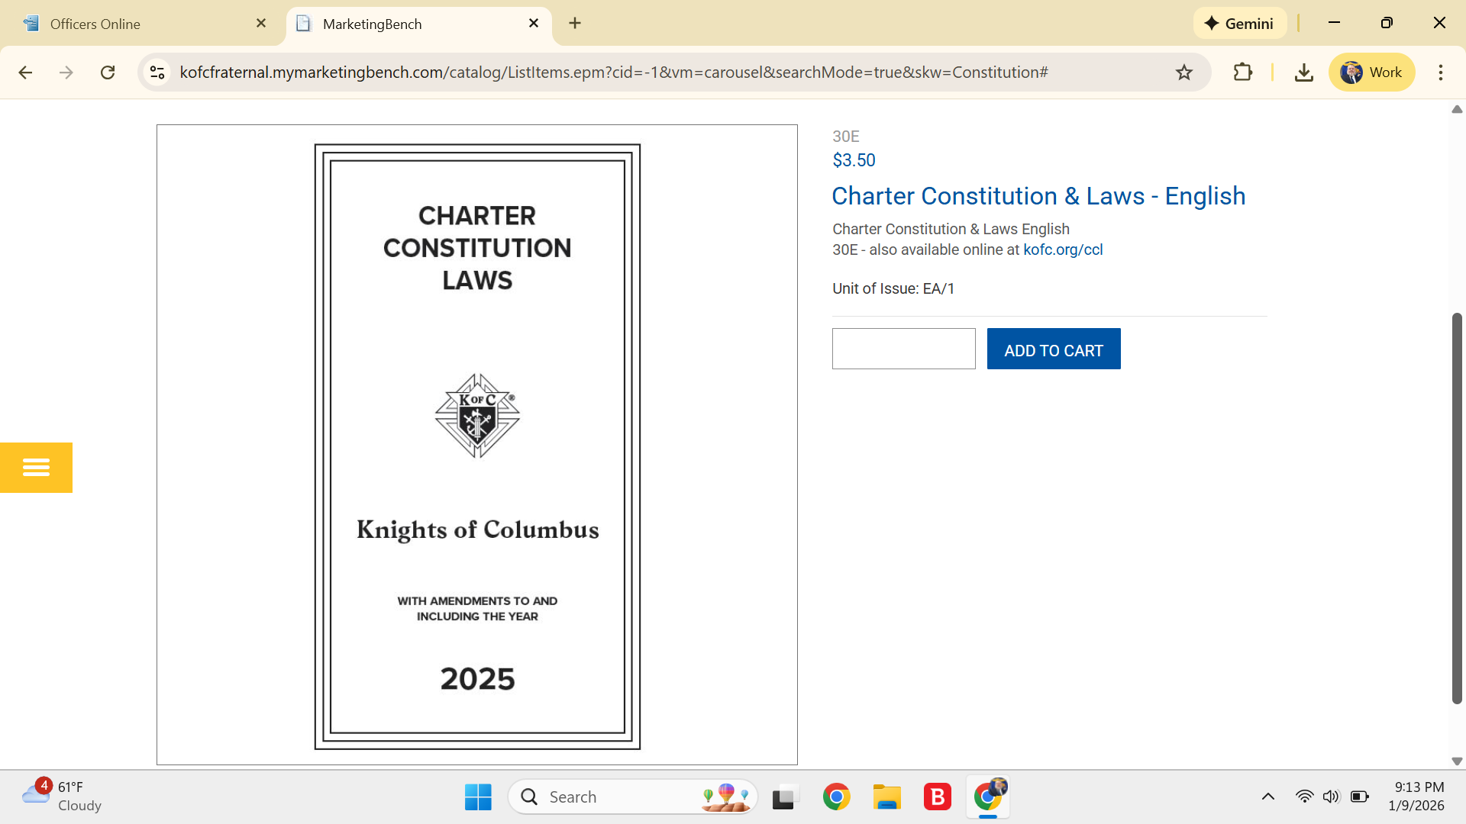
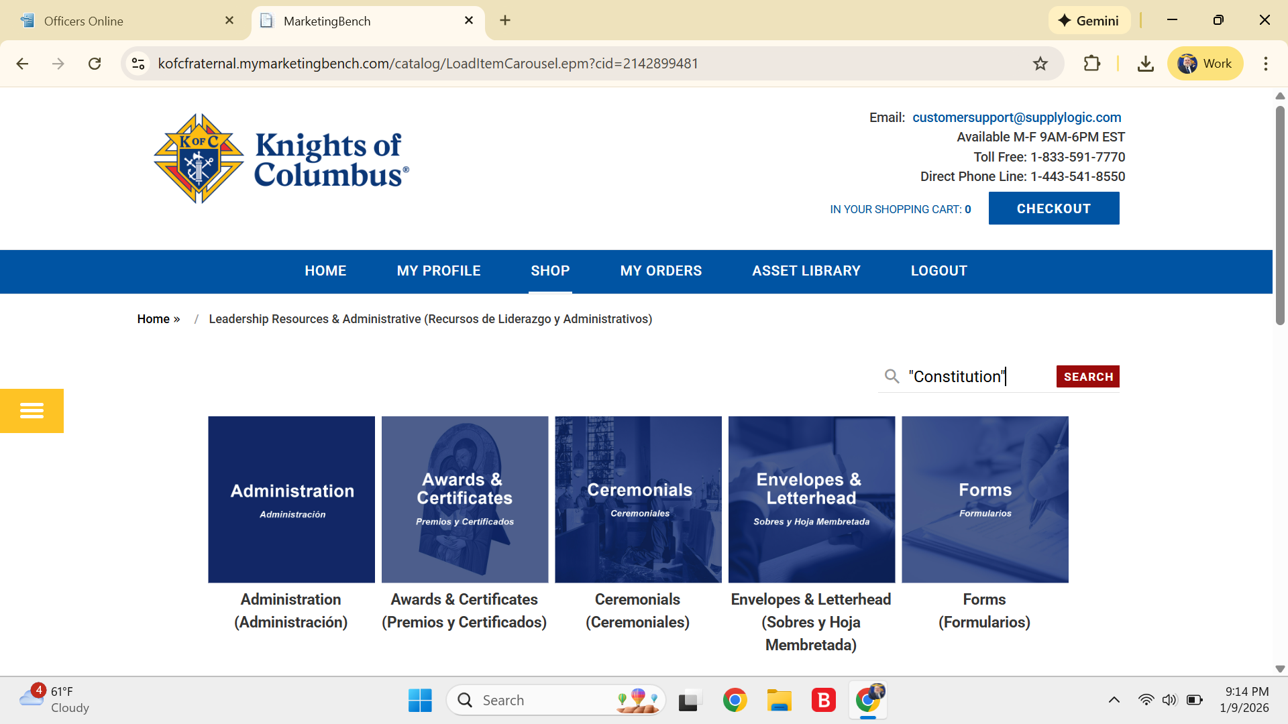
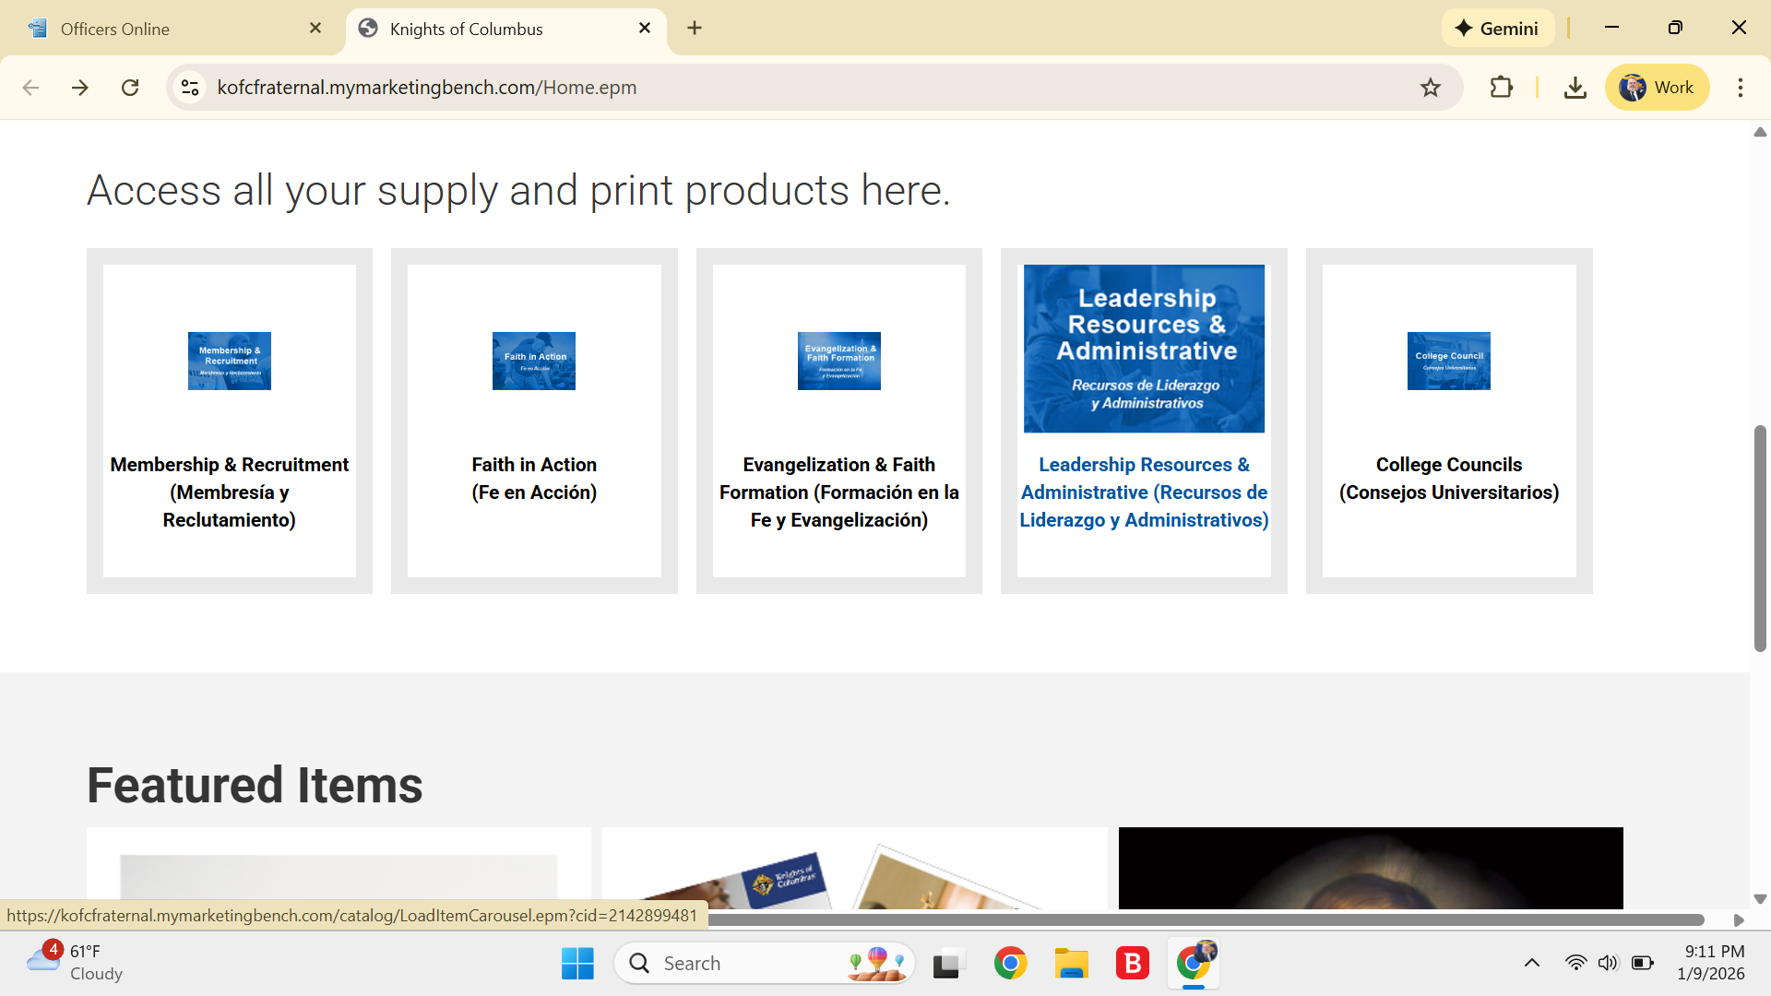
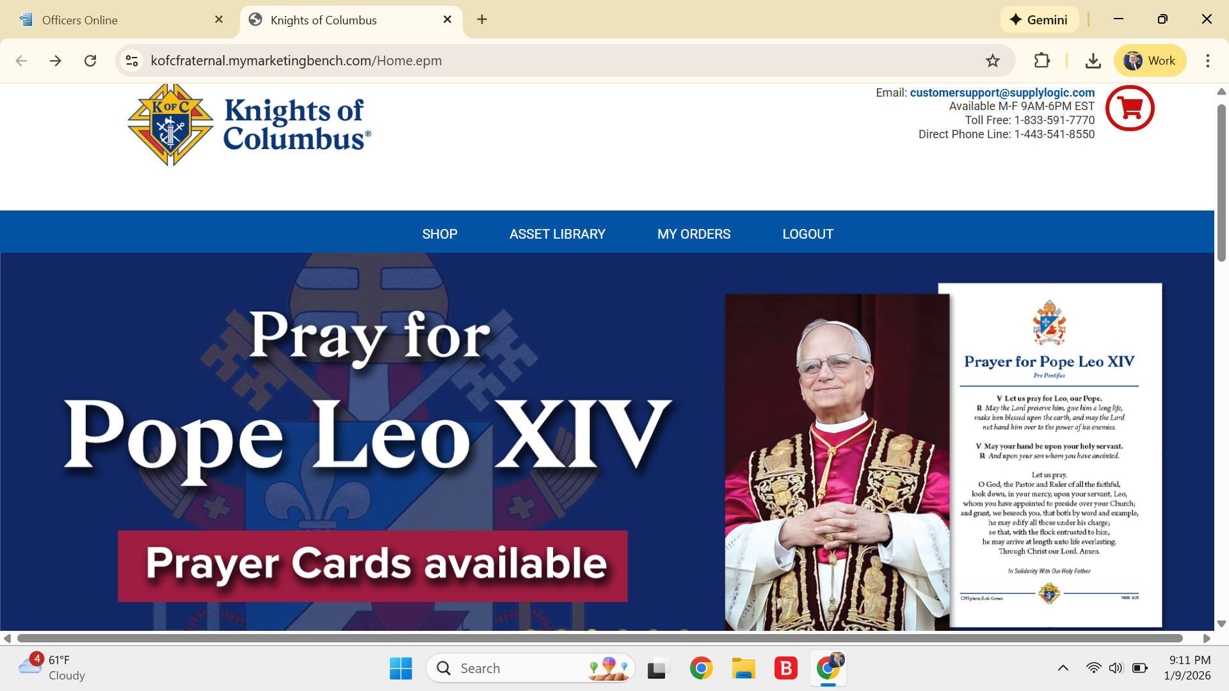
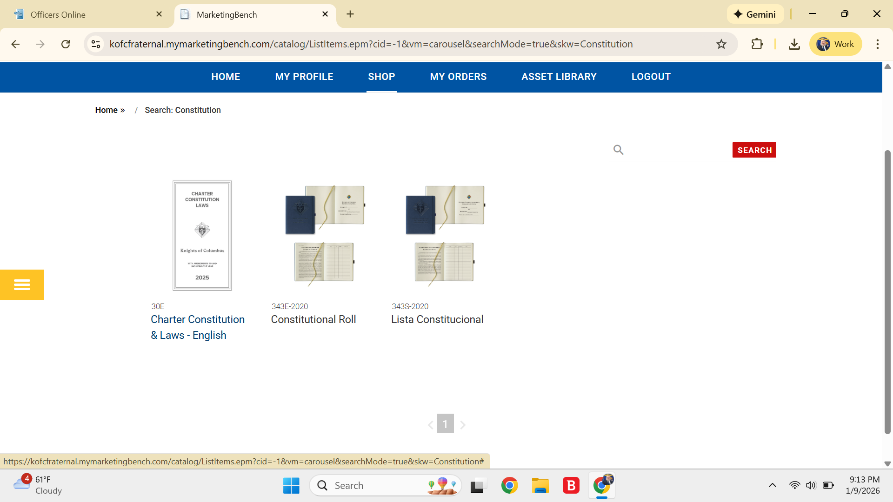
DD as Advocate ByLaws

Slide 7
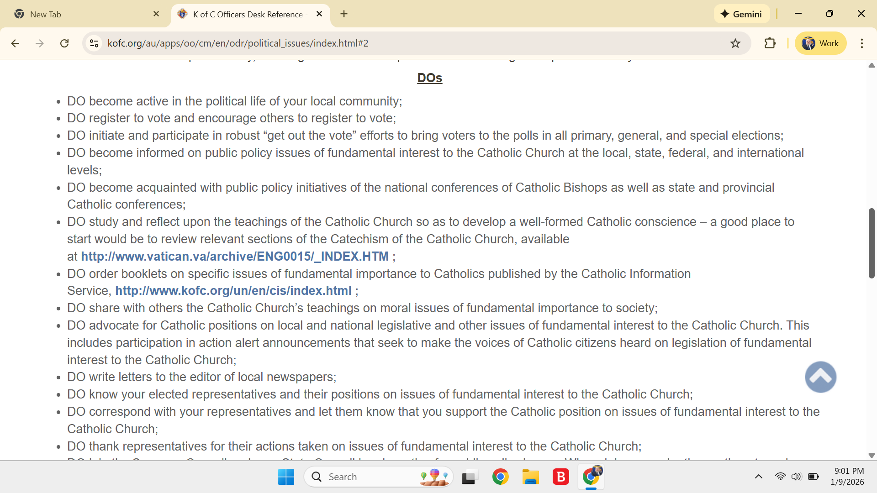
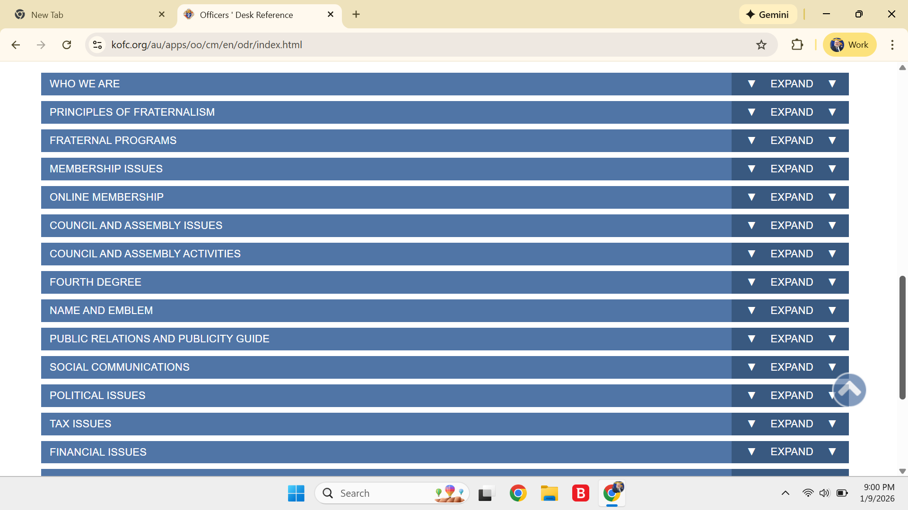
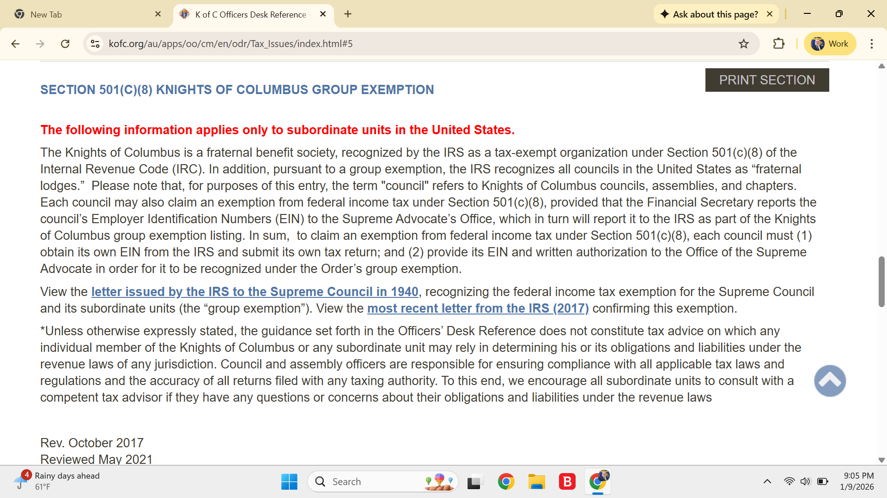
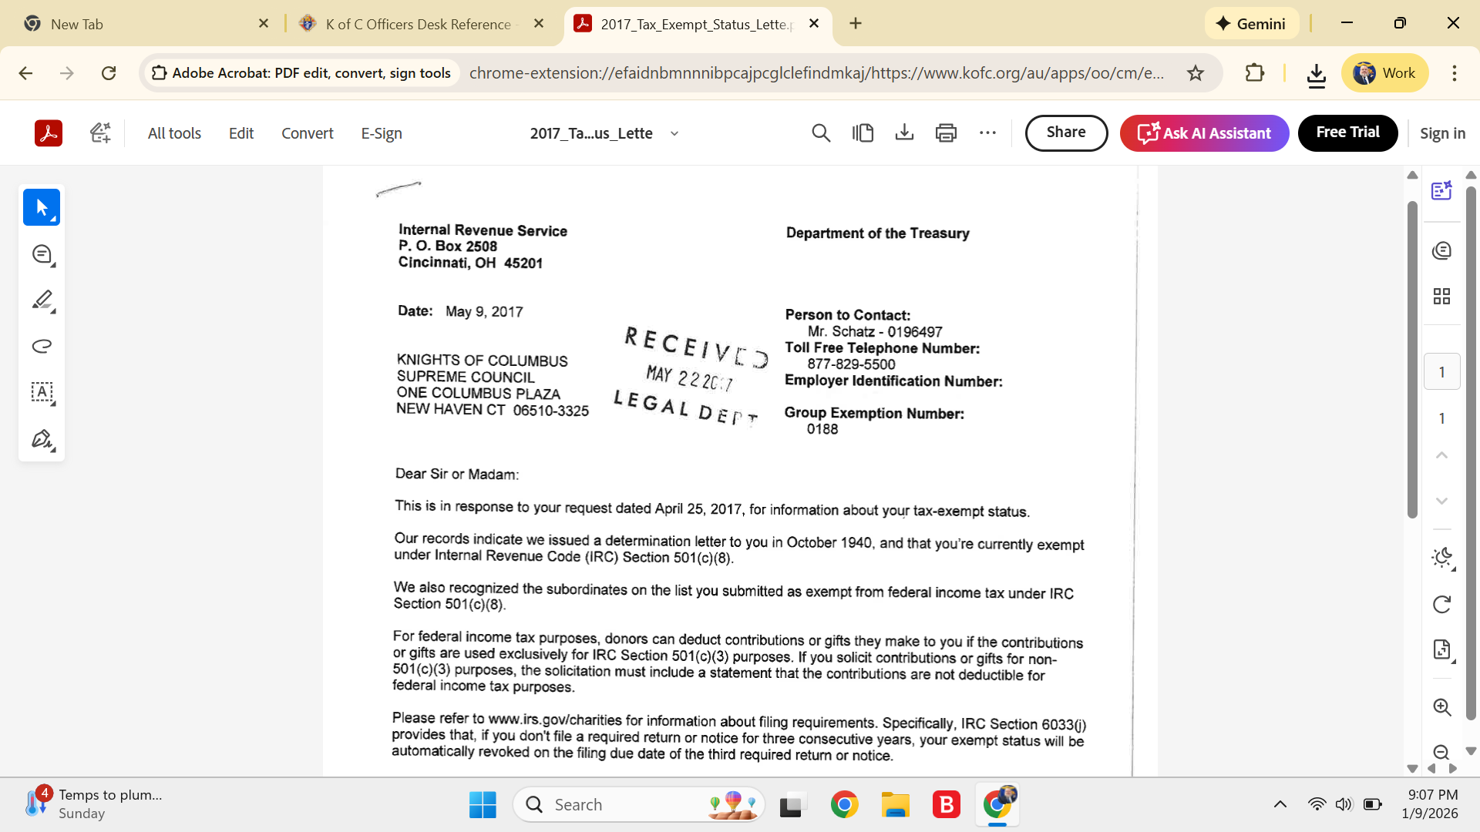
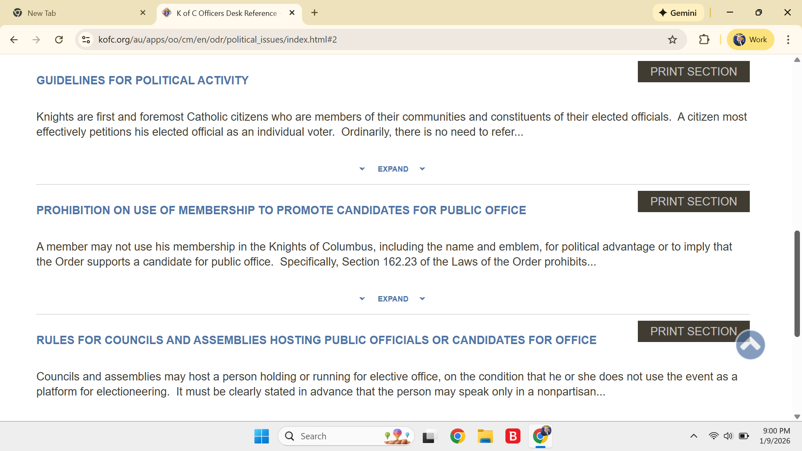
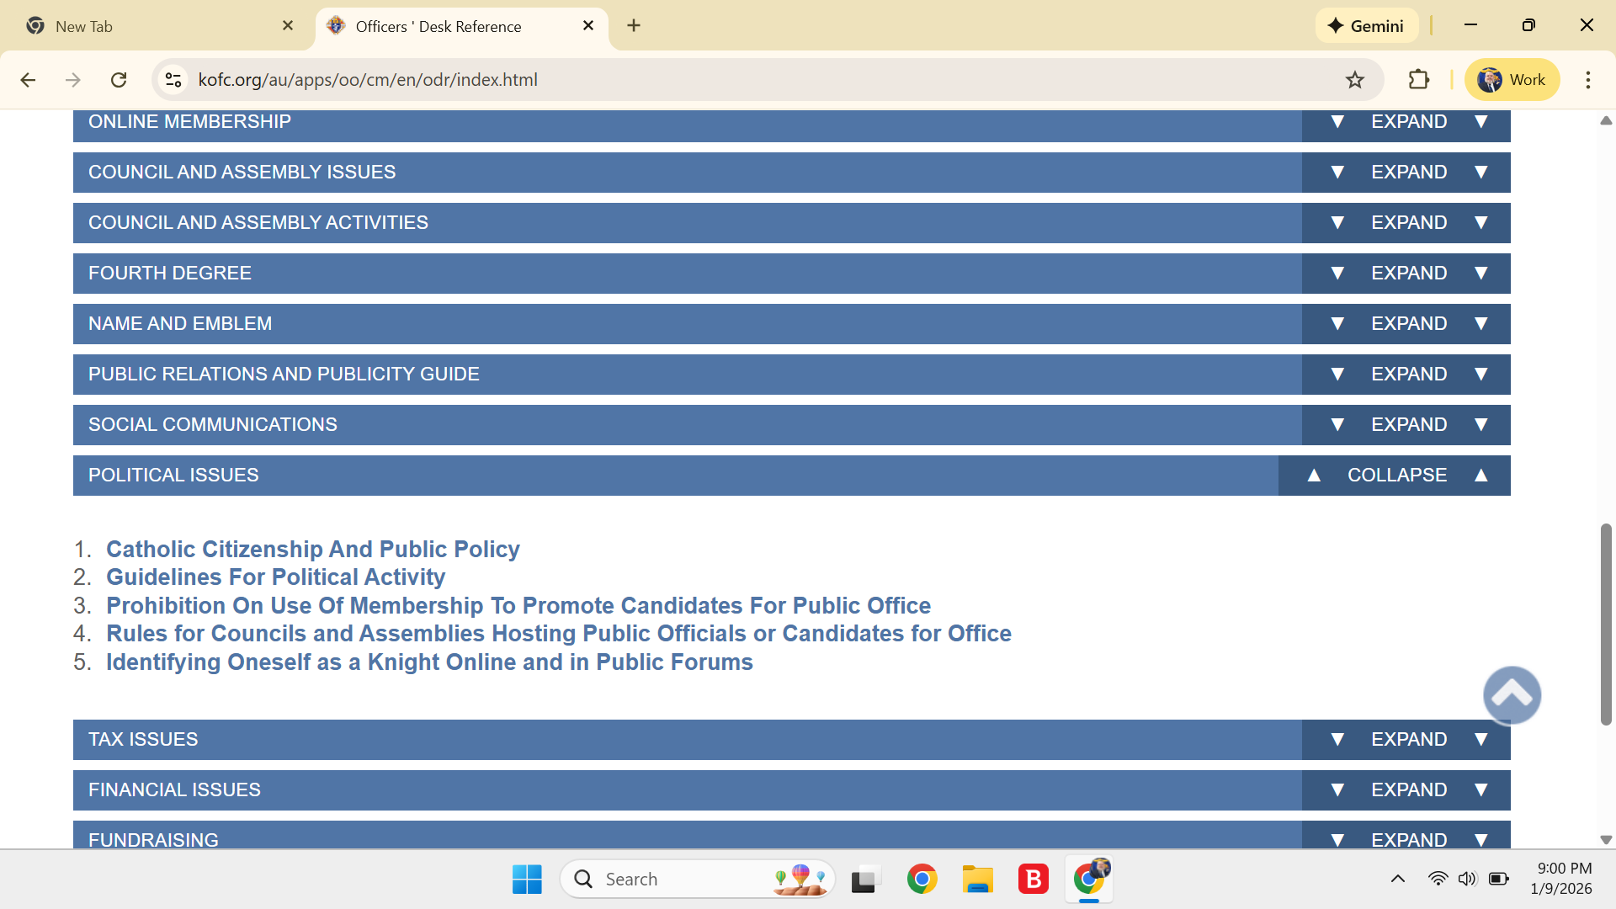
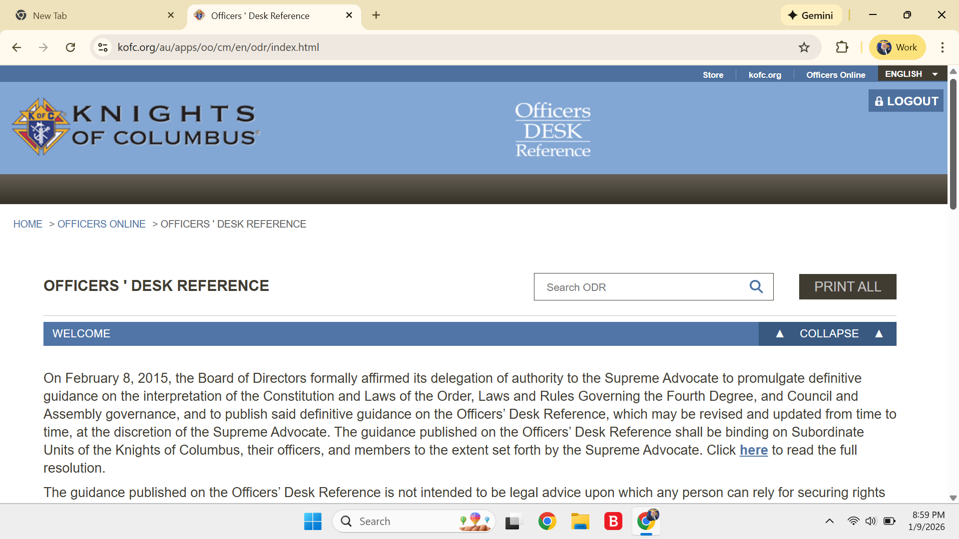
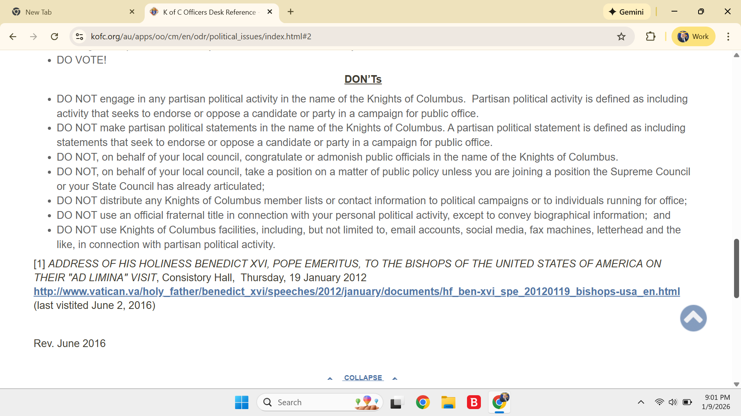
DD as Advocate Office Desk Reference

Slide 8
DD as Evangelist
Primary Function:
Catholic Identity and formation
Tools:
Cor
Faith in Action

Slide 9
DD as Warden
Primary Function:
Oversight and reporting
Tools:
Officers Online
Member Management
Council Forms
Form 944

Slide 10
DD as Warden
Primary Function: Oversight and reporting
Oversight of council Grand Knights, Financial Secretaries, Deputy Grand Knights, other officers
Primary mentor to GK
Ensure council completes all required forms for both Supreme and State Councils

Slide 11
DD as Warden
Tools:
Officers Online on Supreme Web Site
    DD has access to information via reports
      DD Report – Consolidated Information on all DD’s councils
      Councils Not Submitting Officers’ Roster (Form 185)
      Councils Not Submitting Program Directors & Chairs (Form 365)

Slide 12
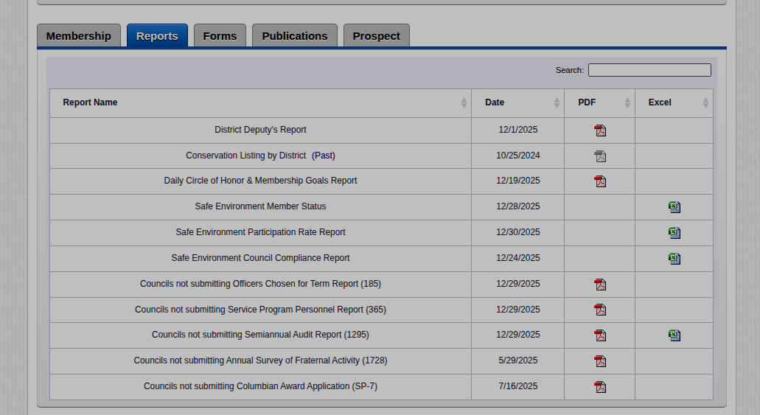

Slide 13
DD as Warden
Tools:
Officers Online on Supreme Web Site
    DD has access to information via reports (continued)
      Safe Environment Reports – 3 Types of Reports
        Member Status
        Council Participation Report
        Council Compliance Report
      Other Reports (Show those councils delinquent)
        Fraternal Activities 1728s
        Audit 1295s
        Columbian Award Applications (SP-7)

Slide 15
DD as Warden
Tools:
Supreme Council Web Site for Council Forms
    https://www.kofc.org/en/for-members/resources/council-forms.html
    Has 19 forms … become familiar with them
    Councils should avoid using Forms 185 and 365 PDFs … use Member Management
    Fraternal Benefits Event Council Report
    What’s Missing???? Access to Online Form 10784
      https://www.kofc.org/en/forms/spa/invite.html?lang=en&form=10784C.01
    Others Forms

Slide 16
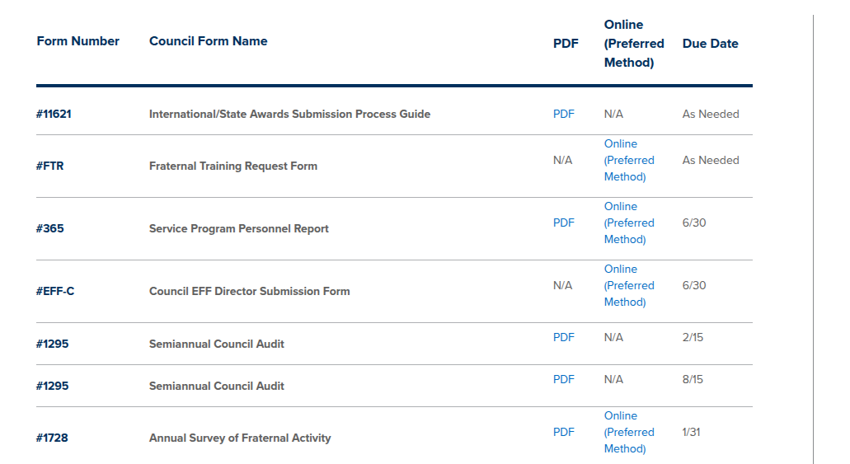
Use Member Management

Slide 17
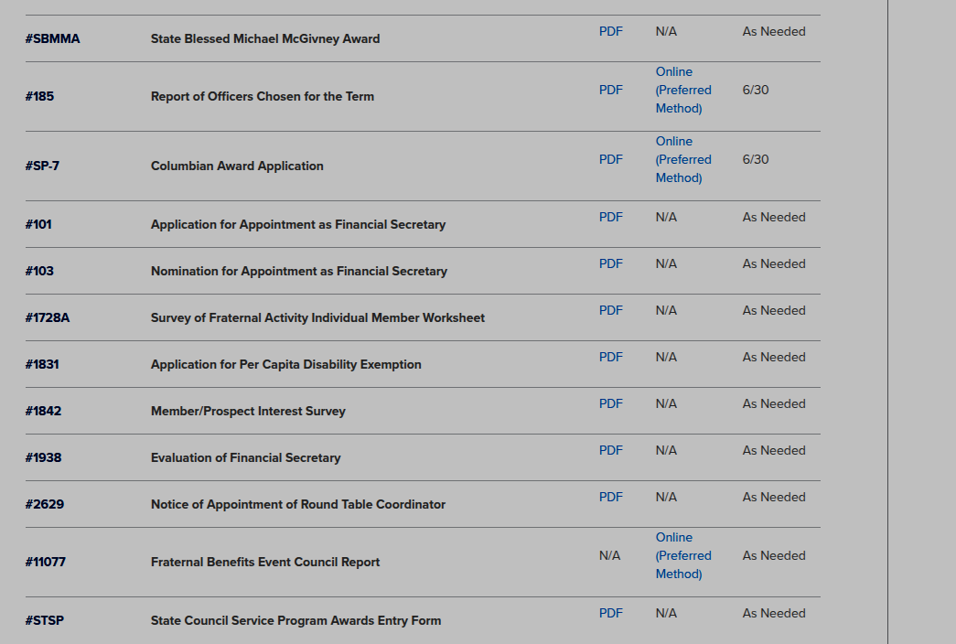
Use Member Management

Slide 18
DD as Warden
Tools:
Form 944
    DD’s reports on the health of the council … complete online annually by 15 September
  Other Resources to Help Monitor Your Councils
    Supreme’s STAR Award Status
      Downloaded by State Deputy
    10784 Report
      Downloaded by State Program Director and Provided to RDDs

Slide 19
DD as Warden
Summary:
DD’s reports on the health of the council … complete online annually by 15 September
  Other Resources to Help Monitor Your Councils
    Supreme’s STAR Award Status
      Downloaded by State Deputy
    10784 Report
      Downloaded by State Program Director and Provided to RDDs

Slide 20
DD as Communicator
Primary Function:
Liaison and unity
Tools:
State and regional correspondence
Order of the Council Meeting (Fraternal Excellence Guide)

Slide 21
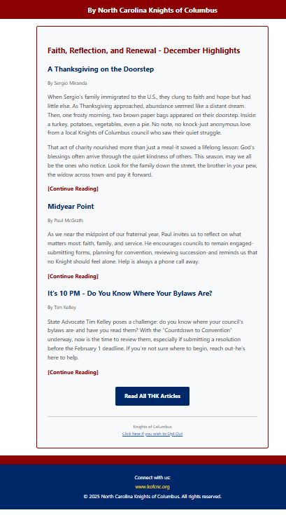
DD as Communicator
Communicator’s Message on Liaison and Unity
Liaison and unity are the foundations of meaningful collaboration. Liaison creates the channels through which people, teams, and communities connect. Unity transforms those connections into shared purpose, mutual trust, and collective strength.
When we communicate with transparency, listen with empathy, and act with intention, we build bridges that withstand challenges and support progress.
In every interaction, we have the opportunity to unite perspectives, align goals, and inspire cooperation. Through liaison and unity, we move forward—not as separate voices, but as one coordinated effort capable of lasting impact.

Slide 22
District Deputies: Effective Communication
Purpose of Communication
As District Deputies, communication is one of your most important responsibilities. You are the official link between the State Council and the local councils in your district. Your effectiveness directly impacts how well councils understand expectations, meet deadlines, and carry out the mission of the Knights of Columbus.
Good communication builds trust, unity, and accountability. Poor communication leads to confusion, missed opportunities, and disengaged councils.

Slide 23
Your Role as the Communication Link
District Deputies serve as a two-way channel of communication:
From the State and Supreme Council to Local Councils
Programs, initiatives, policies, and goals
Deadlines, reporting requirements, and procedures
Changes or updates that affect council operations
From Local Councils to the State Council
Council concerns, challenges, and needs
Best practices and success stories
Feedback on programs and implementation
Your role is not just to pass along information, but to ensure it is understood and acted upon.
District Deputies should consistently:
Maintain regular contact with Grand Knights and council officers
Provide clear explanations of expectations and deadlines
Follow up to confirm information was received and understood
Encourage participation in programs, meetings, and events
Offer guidance and support when councils face challenges
Communication should be timely, accurate, and respectful, always reflecting the
values of the Order.

Slide 24
Effective Communication Methods
Successful District Deputies use multiple communication tools:
Email for official notices, deadlines, and documentation
Phone calls for clarification, encouragement, or problem-solving
In-person or virtual meetings for relationship-building and planning
District meetings to reinforce key messages and share best practices
No single method works for every situation. Choose the method that best ensures the message is received and understood.
Best Practices for Success
Be consistent — communicate regularly, not only when there’s a problem
Be clear and concise — avoid confusion or assumptions
Be approachable — councils should feel comfortable reaching out
Be responsive — timely replies build confidence and trust
Be positive and encouraging — your tone sets the standard

Slide 25
Closing: Why Communication Matters
Strong communication strengthens councils, improves participation, and advances the mission of the Knights of Columbus. As District Deputies, when you communicate effectively, you help councils succeed—and when councils succeed, the entire Order grows stronger.

Slide 26
DD as Financial Secretary
Primary Function:
Financial integrity
Tools:
Officer Desk Reference - Financial Issues

Slide 27

DD as CEO
(Chief Encouragement Officer)
Primary Function:
Moral and recognition
Tools:
State Council Recognition Manual
Supreme Awards
  Columbian Award
  Father McGivney Award
  Founders Award
  Star Council Award
  Multiple Star Council Award

Slide 28
District Deputy as CEO
NC State Deputy Award
  Council Representation at meetings
  Achieve “Charity” Recognition
  State Council Recognition
  Pay Council Assessments
  Submit Required Reports to Supreme
  Meet or Exceed Supreme Membership Goals
  Submit Three Nominations
  Be Safe Environment Compliant

Slide 29
DD as CEO
State of the Year Awards
  State Priest of the Year
  State Deacon of the Year
  State Knight of the Year
  State Rookie of the Year
  State Golden Knight of the Year
  State Family of the Year

Slide 30
DD as CEO
Council Recognition Awards
  Charity – Highest Award
  Unity – Second Highest Award
  Fraternity – Third Highest Award
  Best Service Program
  The Dune Russell Award – Council Newsletter
  Council Website

Slide 31
DD as CEO
Keep Christ In Christmas Poster Contest (Family Program)
Essay Contest (Community Program)
Council Divisions
  Div. 1 – 1 - 49
  Div. II – 50 – 81
  Div. III – 82 - 149
  Div. IV – 150 – and up

Slide 32
DD as Builder
Primary Function:
Growth and expansion
Tools:
Council Revitalization

Slide 33
DD as Enforcer
Primary Function:
Ensure Council Officers & Directors are at the Least Meeting Expectations
Tools:
Supreme Council By-Laws
Council By-laws
District Deputy’s Guide
Fraternal Excellence
Officers’ Desk Reference
Regional District Deputy
State Officers

Slide 34
DD as Enforcer
There may be times when a council officer, director, or chair is not performing the requirements he has in his position.
DD’s responsibility is to watch out for possible weak links in the council that may cause the council to fail critical responsibilities.
Sometimes the GK may bring an issue to the DD that the DD should not ignore.
DD needs to assess the role, person, and the situation.
DD should get advice from RDD, state officers

Slide 35
DD as Enforcer
If something is illegal must get RDD, State Deputy, State Secretary, and State Advocate involved.
Reporting Allegations of Sexual Misconduct – ZERO TOLERANCE
    A state or local council officer or a district deputy should notify the Office of Youth Protection at oyp@kofc.org as soon as possible when he becomes aware that a member has ever been:
      CHARGED WITH OR FOUND GUILTY BY A COURT OF ANY OFFENSE INVOLVING CHILDREN;
      CHARGED WITH OR FOUND GUILTY BY A COURT OF ANY SEX-RELATED OFFENSE; OR
      SUED IN COURT FOR ANY WRONGFUL CONDUCT AGAINST CHILDREN OR FOR A SEX-RELATED OFFENSE.

Slide 36
DD as Enforcer … Resources
Supreme Council By-Laws …
  https://www.kofc.org/en/forms/leadership/charter-const-laws30.pdf
Council By-laws ...
  Ask your councils for copies … only a few items can be modified by a council
District Deputy’s Guide …
  https://www.kofc.org/en/forms/leadership/district-deputy5087.pdf
Fraternal Excellence Guide …
  https://www.kofc.org/en/resources/for-members/11619-fraternal-excellence-guide.pdf
Officers’ Desk Reference …
  Available through Officers Online

Slide 37
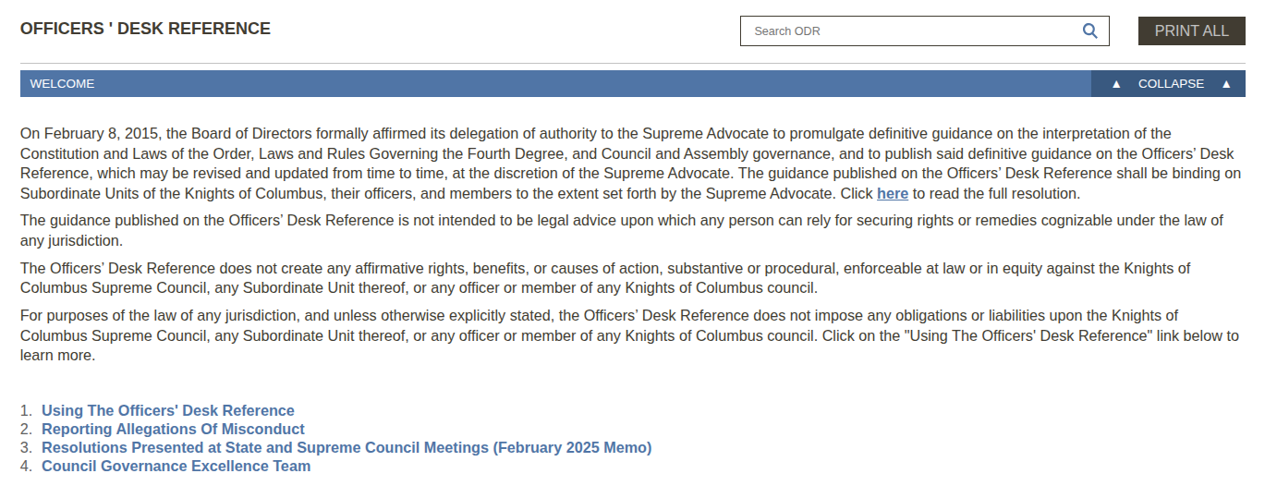

Slide 38
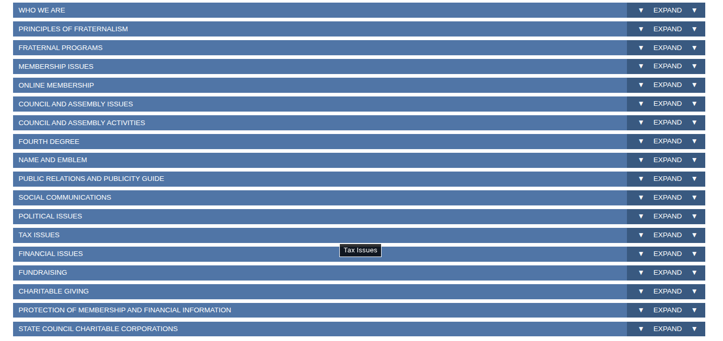

Slide 39
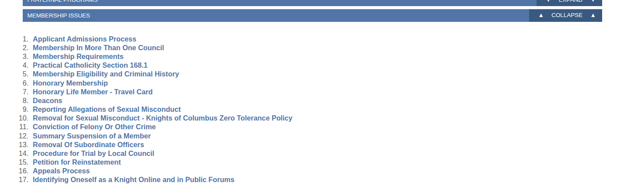

Slide 40
DD as Enforcer
Anecdotes:
    RDD1 Gene Ziemba … “Who Does He Think He Is?”
    RDD7 Jim Coyle …
    RDD5 Tom Kotz … “When No One in the Council Wants to Step Up”

